Slide 1
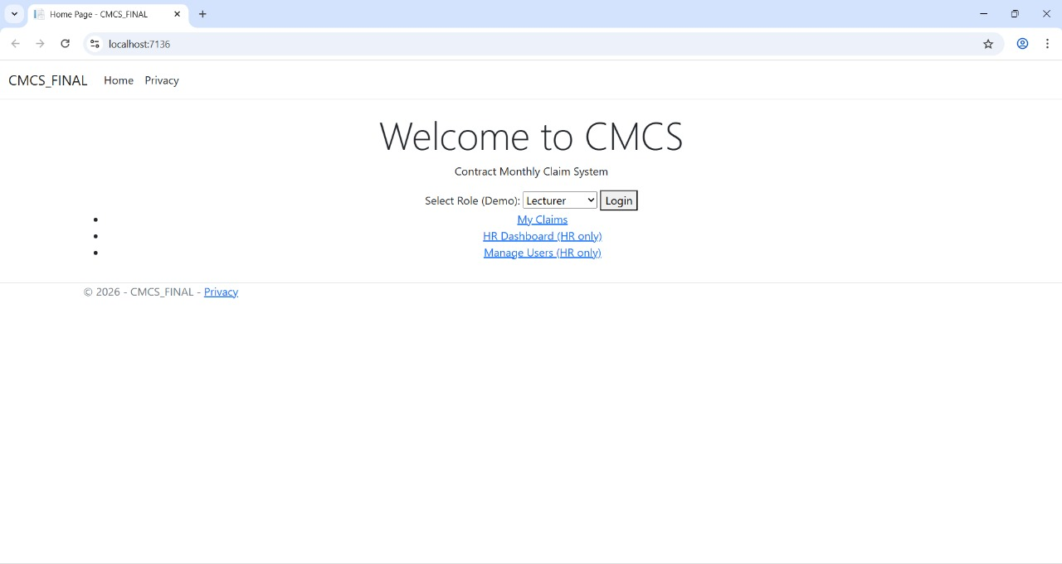
Contract Monthly Claim System (CMCS)
POE Part 3 – Programming 2B (PROG6212)
JADEEL KISTEN
ST10339718
January 2026
Notes:
Welcome everyone. Today I’ll be presenting my university project titled Contract Monthly Claim System, or CMCS, for Programming 2B – POE Part 3.

Slide 2
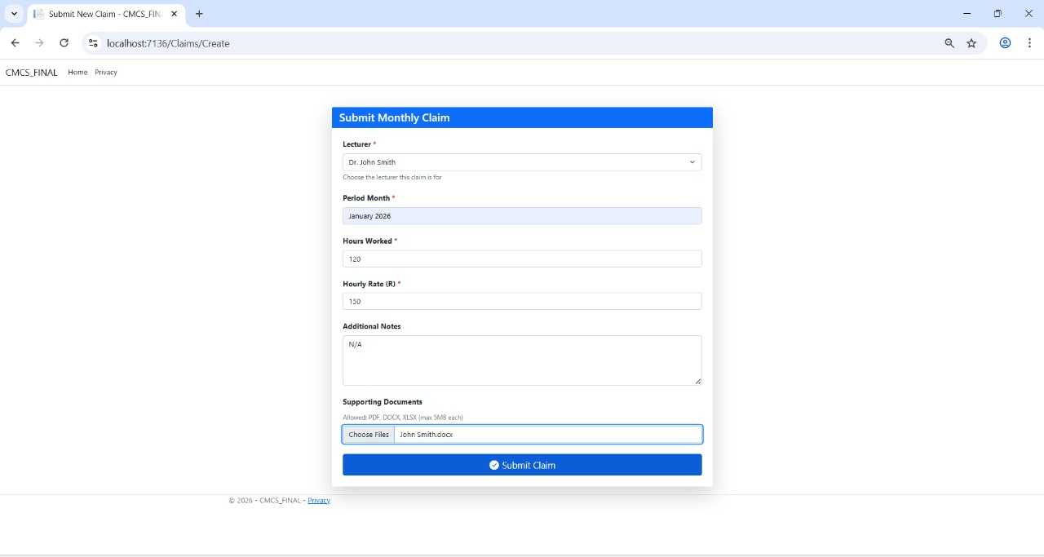
Introduction & System Overview
Lecturer submits monthly claim
Coordinator verifies claim
Manager approves claim
HR generates reports and manages users
Notes:
CMCS is a web-based system where lecturers submit monthly claims, coordinators verify them, managers approve them, and HR generates reports and manages users.

Slide 3
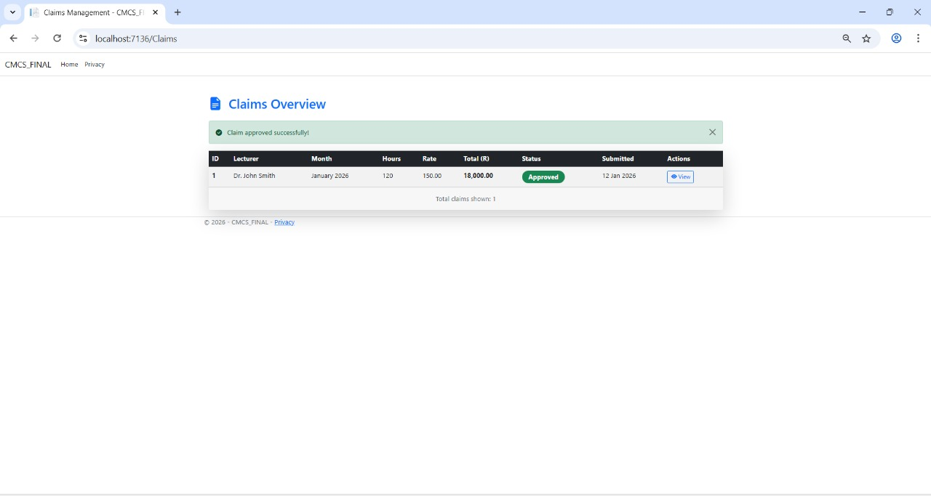
Extra Features & Techniques
Auto-calculation of totals
AES encryption for uploads
Bootstrap-based responsive UI
Session-based role simulation
Notes:
Here are some of the extra features I implemented: automatic calculation of totals, AES encryption for document uploads, a responsive Bootstrap UI, and session-based role simulation.

Slide 4
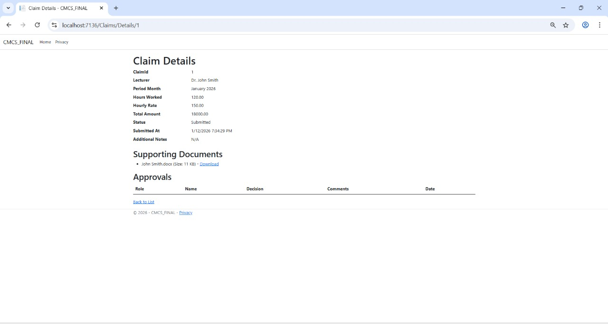
Security & Role Implementation
AES encryption secures uploaded files
File validation ensures correct formats
Session-based roles simulate user access
Notes:
Security is a key focus. Uploaded files are validated and encrypted using AES. The system simulates user roles using session data to control access and visibility.

Slide 5
Key Code Overview
Notes:
Let’s look at some of the key code. I’ll highlight the methods for calculating totals, encrypting files, and handling the Create POST action for claims.

Slide 6
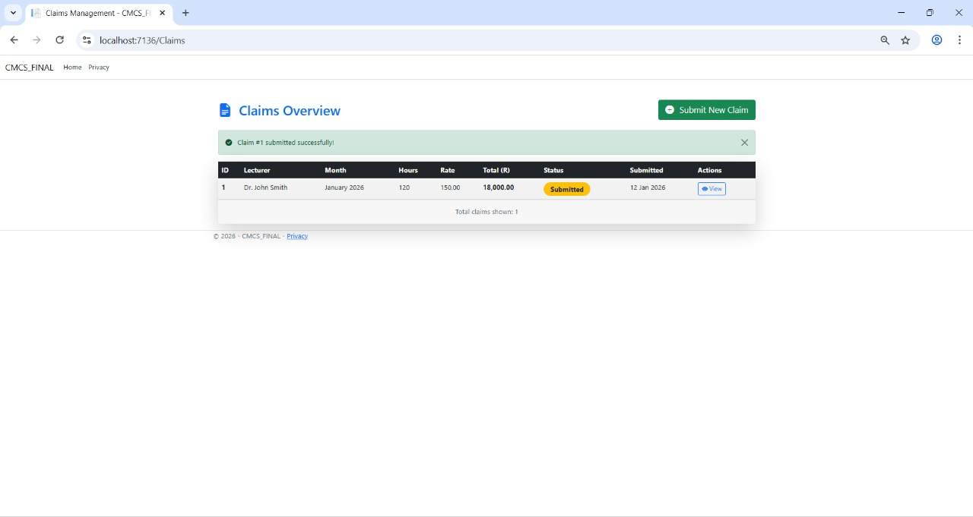
Demo – Lecturer Submits Claim
Notes:
First, the lecturer logs in and submits a claim. The form captures hours, rate, and uploads a document. After submission, the claim appears in the lecturer’s dashboard.

Slide 7
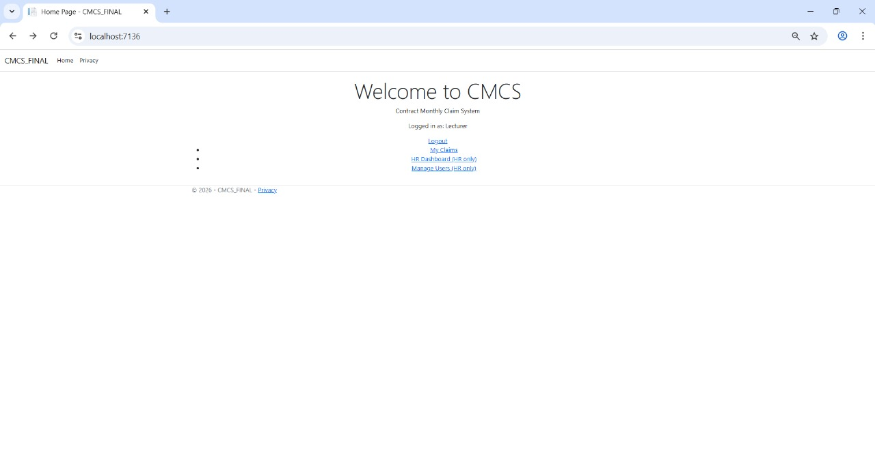
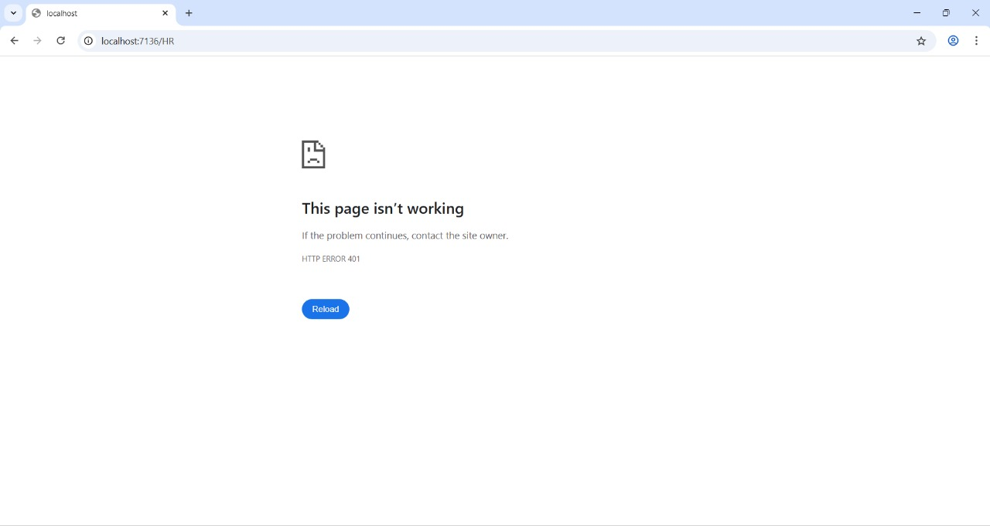
Demo – Error Handling & Validation
Notes:
If there are any issues, the system shows validation errors. This ensures data integrity and user feedback.

Slide 8
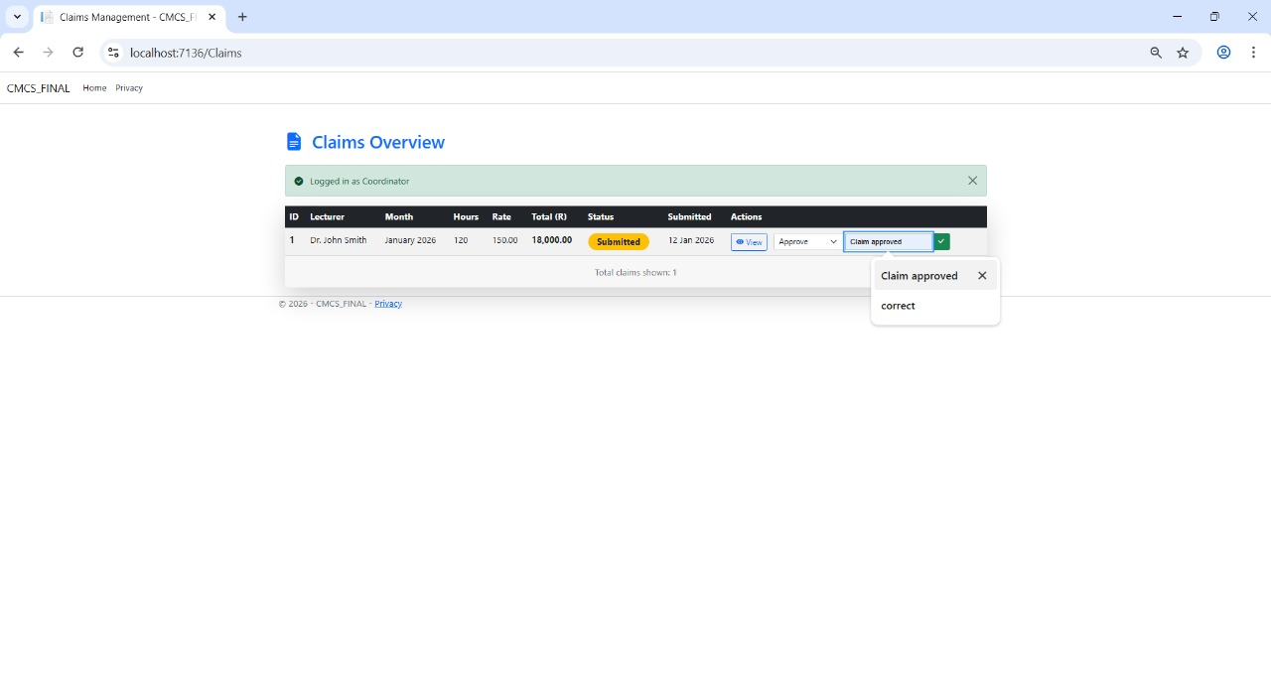
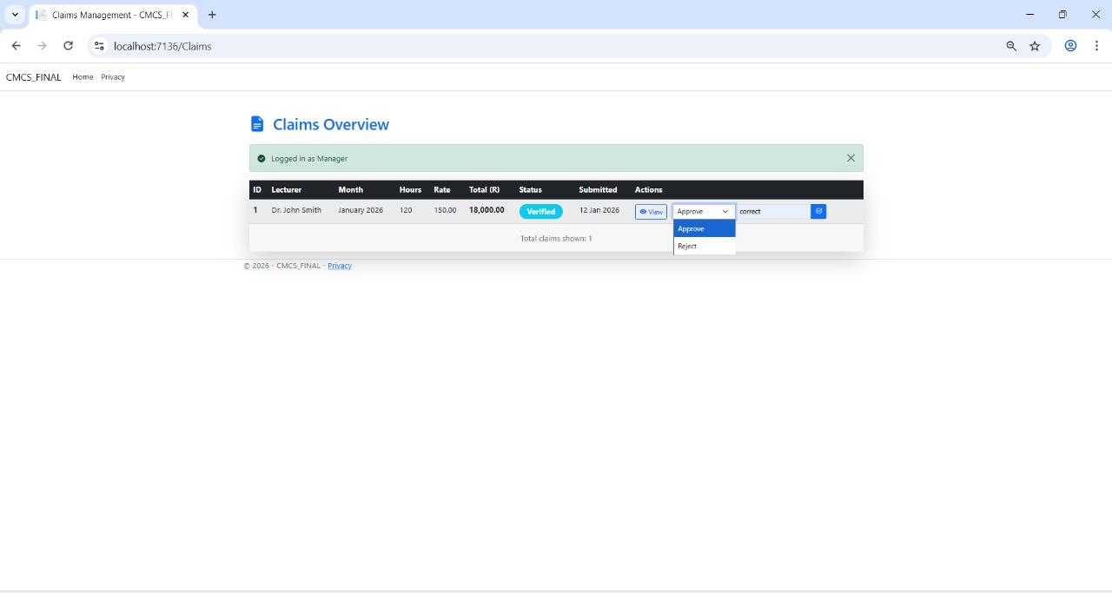
Demo – Coordinator & Manager Workflow
Notes:
Next, the coordinator reviews the claim and approves it. Then the manager does the final approval. Each role sees only what they need to.

Slide 9
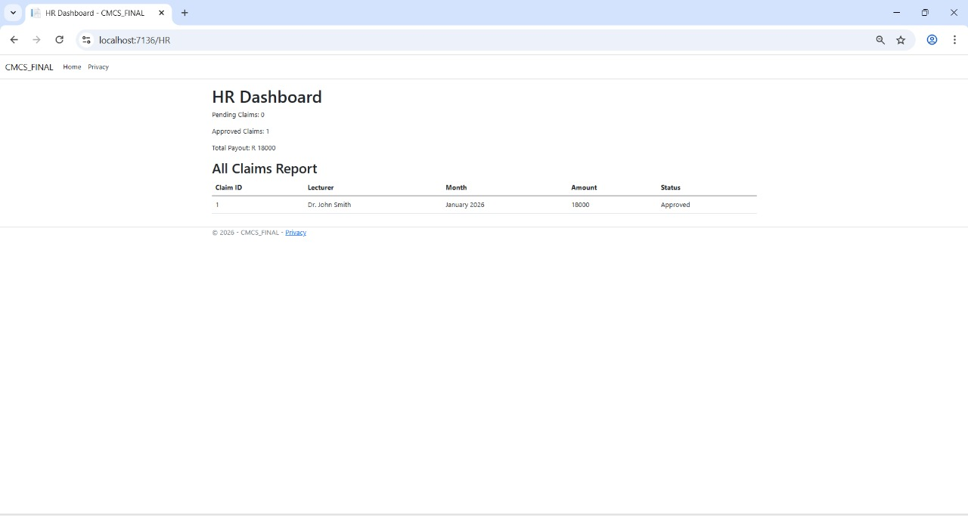
Demo – HR Dashboard
Notes:
Finally, HR can view the dashboard with statistics and manage lecturers. This helps with payroll and reporting.

Slide 10
Conclusion
Streamlined claim process
Role-based access control
Secure document handling
Thank you.
Notes:
In conclusion, CMCS streamlines the monthly claim process with role-based access, automation, and security. Thank you for your attention – I’m happy to take any questions.

